Slide 1
2019 Australian Bushfires and Weather Trend Analysis
Group 16
Olivia Alexander 014545986
Jeehee(Ginny) Choi 012565696
Sukriti Mishra 014580696 Ziwei(Sophia) Song 014557231

Slide 2
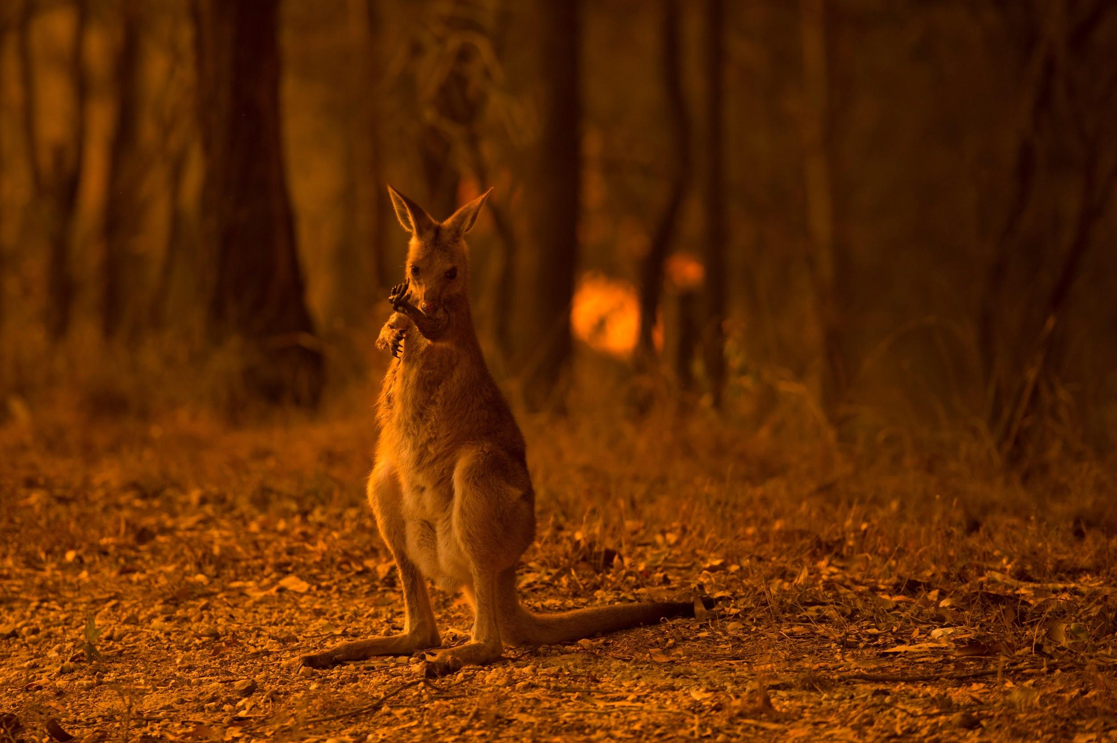
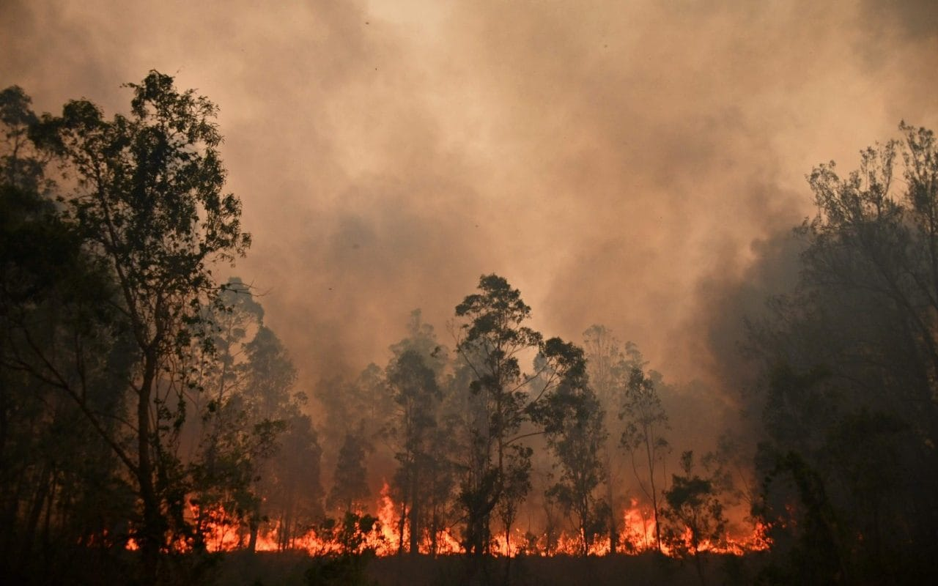
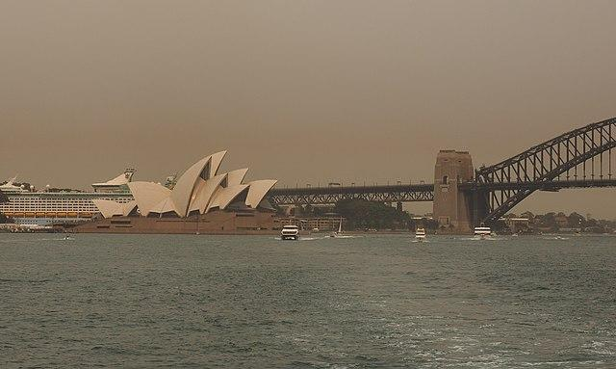
Introduction
An estimated 1.25 billion animals have been lost.
Since September 2019, at least 27 million acres of Australia have burned.
Australia’s bushfires have released 400 megatons of carbon dioxide into the atmosphere, and caused health threat, global warming.

Slide 3
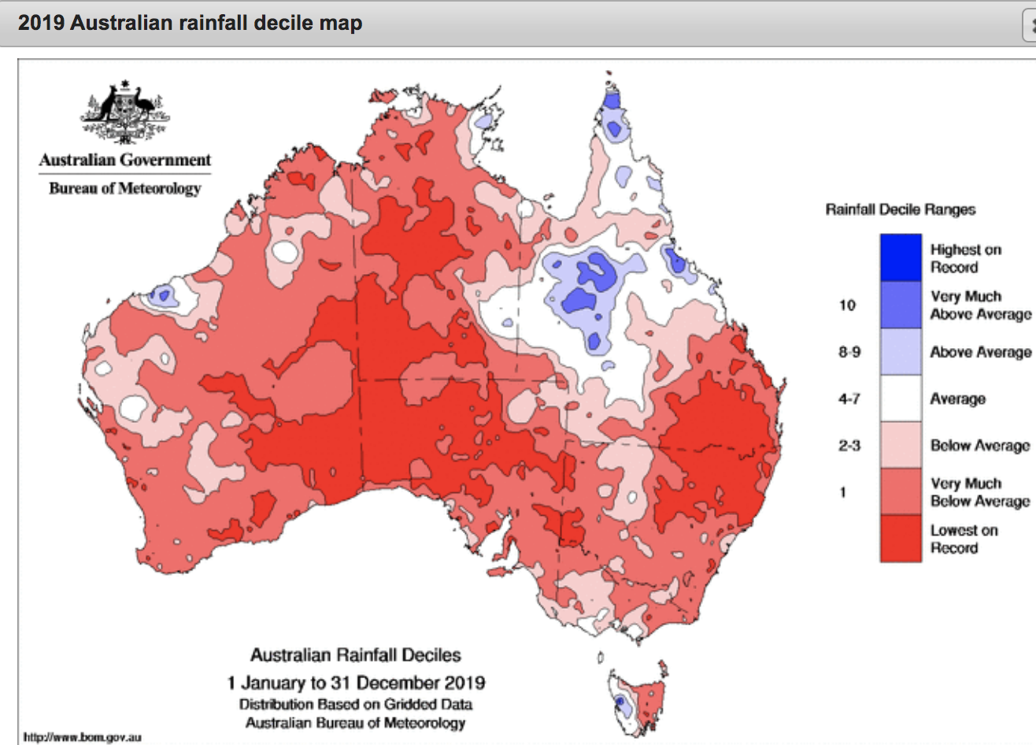
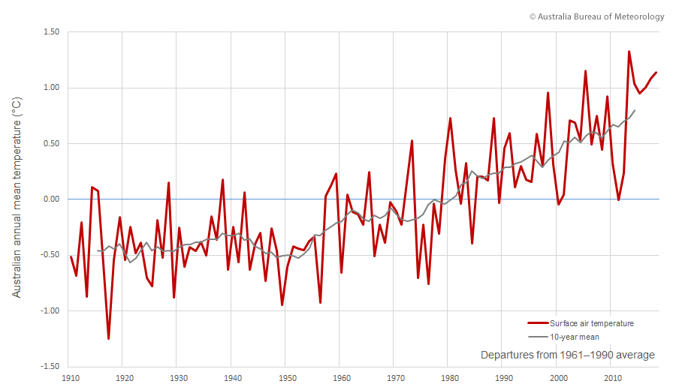
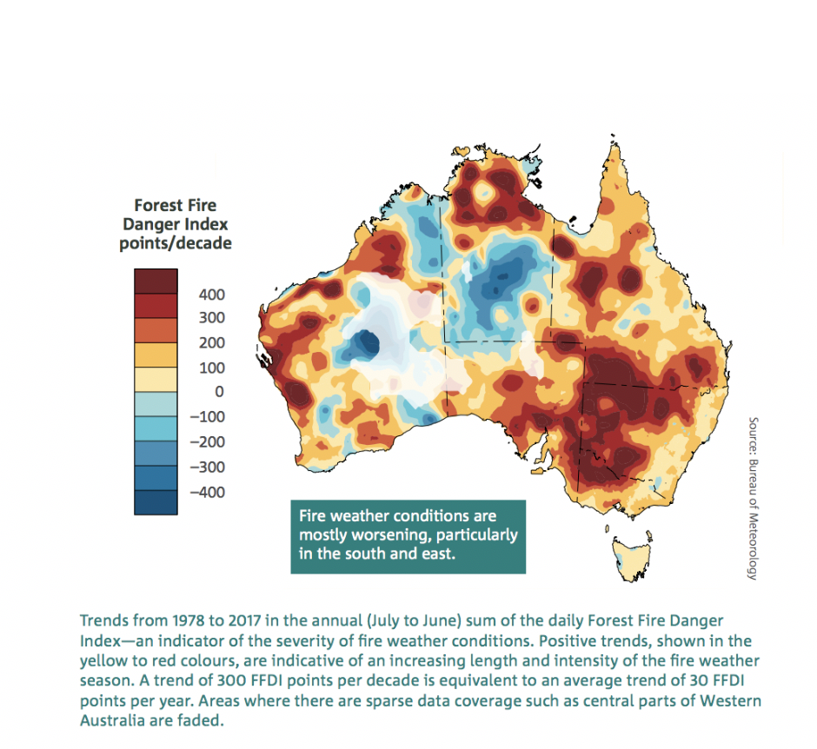
Introduction
2019 Australian Rainfall Map
Australia Annual Mean Temperature
FFDI Index

Slide 4


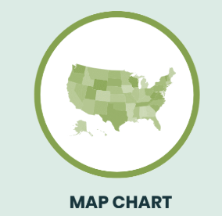
Purpose of the project
(1) Examine the timeline of fires in Australia as well as the timeline of weather patterns during the bushfires as they were most severely occurring in late 2019.
(2) Explore the states, regions of Australia that were most adversely affected by these events. With the analysis of the bushfires, patterns or trends of the fires can be detected in order to make predictions for future reference.
(3) Study the natural causes of the fire in the form of historical weather readings. Search for any correlations or trends over time for weather variations and subsequent fires as a sign of climate change.

Slide 5
Supporting Work
Title : Climate change impacts on fire-weather in south-east Australia
Author: K. Hennessy, C. Lucas* N. Nicholls* J. Bathols, R. Suppiah and J. Ricketts
Topic: This work explored how the fire-weather risk is related to climate change and proposed improved methods on assessments of fire risk. Fire-weather risk is affected by a number of weather variables including temperature, humidity, wind speed and precipitation.
Method: In order to measure the fire-weather risk in a numerical way, Forest Fire Danger Index (FFDI) was introduced as it is commonly used by weather forecasters and fire services agencies in Australia as an indicator of risk and hazard of forest fires.
Result: This work analyzed FFDI results compared with climate change simulation results.Hennessy et al. mentions Sydney and Coffs Harbour as case studies.And the risk of fire weather for the two major cities are potentially high in the future.
Title: Big data integration shows Australian bush-fire frequency is increasing significantly
Author: R. Dutta, A. Das and J. Aryal
Topic: There is an aim to derive the contextual information of a model to calculate accurate prediction for future bushfire hotspots.
Method: From weekly climatic surfaces, researchers developed an ensemble method on the basis of a two-layered machine learning model to establish a relationship between fire incidence and climatic data to provide highly accurate bushfire incidence hot spot estimation with a global accuracy of 91%
Result: Their analysis also showed that Australian weekly bushfire frequencies increased by 40% over the last 5 years, especially during the late summer months, indicating a serious climatic shift. Data from two NASA satellites, the Terra and Aqua satellites, detect the emission of infrared radiation by fires.

Slide 6
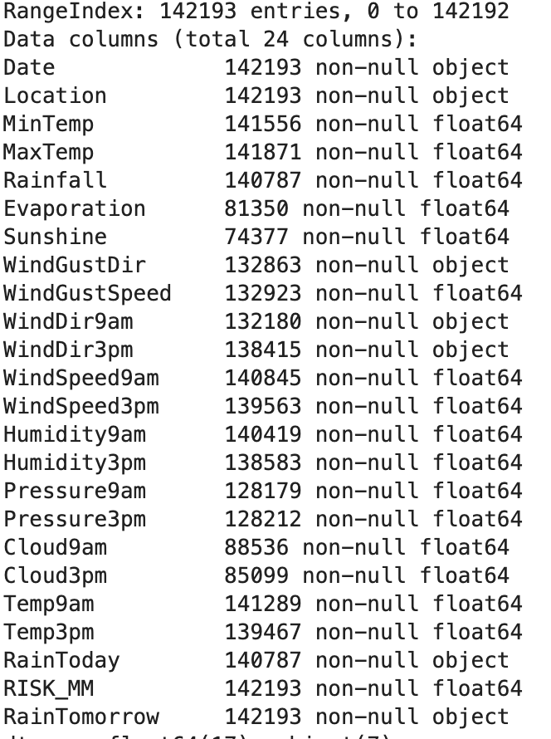
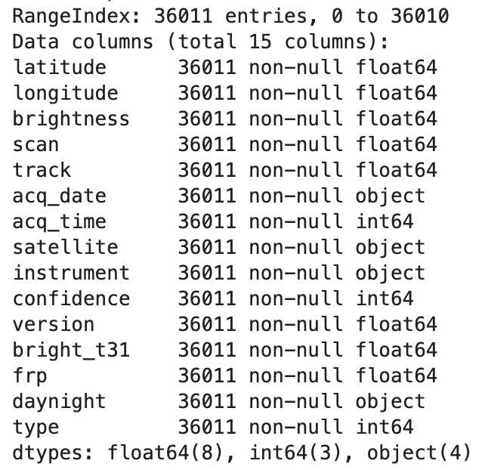
Data Collection
Open-source database
Australian Government Bureau Of Meteorology (BOM)
Kaggle
Fire Dataset
08.01.2019 - 01.11.2020
Weather Dataset
12.01.2008 - 12.31.2019

Slide 7
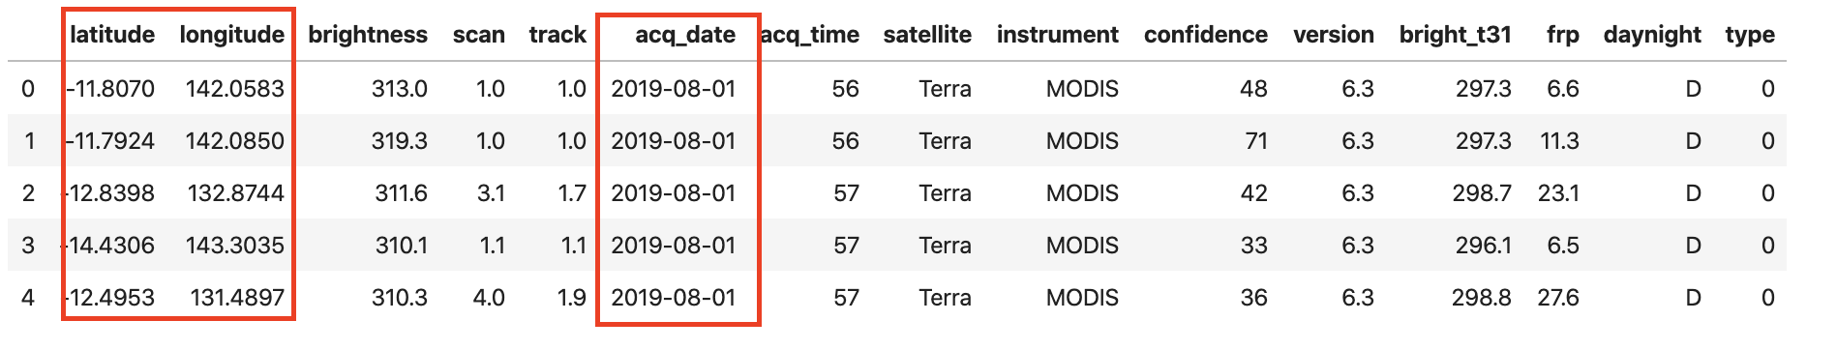
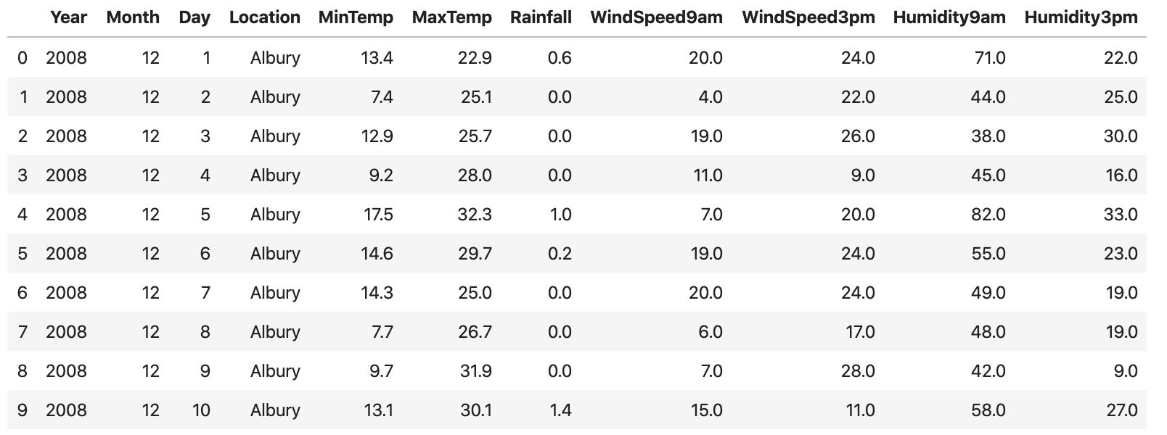
Feature Selection
Fire Dataset: Latitude, Longitude, Date
Weather Dataset: Location, MinTemp, MaxTemp, Wind Speed, Rainfall, Humidity

Slide 8
Data Visualization
Part 1 - Australian Bushfires from August to December 2019
Part 2 - Historical Australian weather trend from 2008 to 2018 in five main weather features
Notes:
10-15 slide: Ginny
In this project, we examined the visualization products in two forms.
Part 1 Explores the occurrence of 2019 Australian Bushfires from August to December.
Part 2 Explores the historical Australian weather trend from 2008 to 2019 in five main weather features

Slide 9
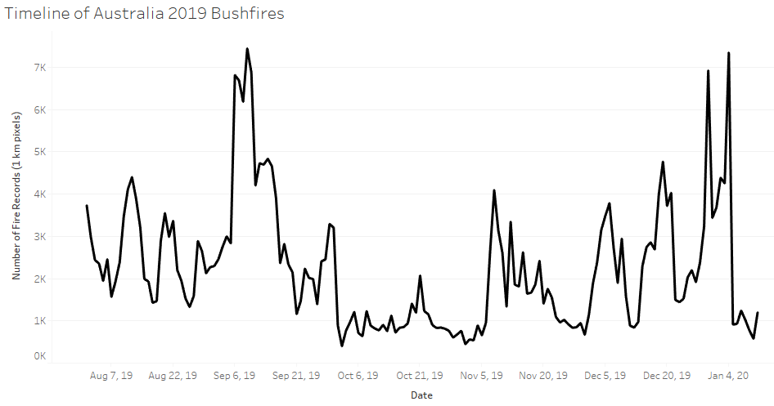
Data Visualization Part 1 - Fire Dataset (1)
Notes:
To have a better understanding of the severity of 2019 bushfires in Australia, we created the a line graph with time series.
We can see that the number of fires peaked in mid September 2019, decreased in October, showed ups and downs in November and December, and peaked again in early January 2020, then decreased afterwards.

Slide 10
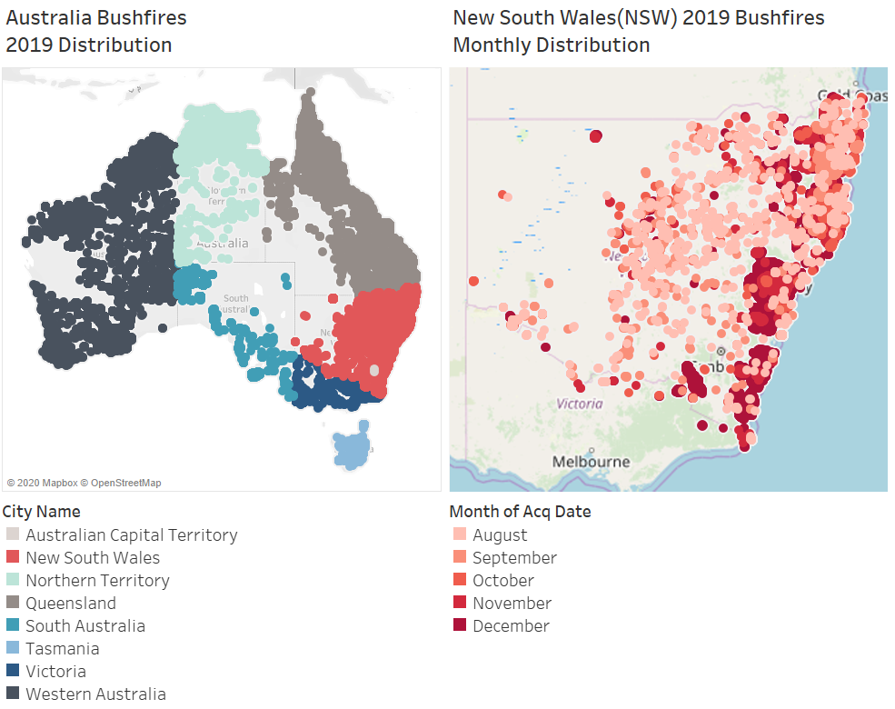
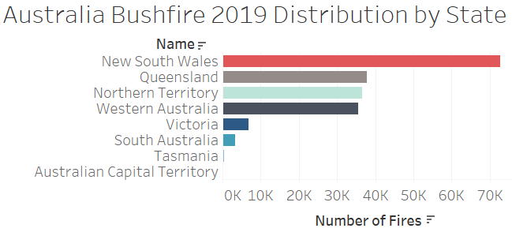
Data Visualization Part 1- Fire Dataset (2)
Notes:
The left graph shows the distribution of 2019 Australian Bushfires from August to December 2019. We can see that the bushfires spread all over the coasts of Australia. The right hand side shows the fire distribution by State of Australia in 2019. Above 70,000 fire events occurred in New South Wales.

Slide 11
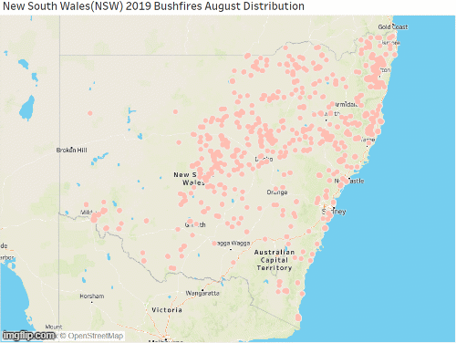
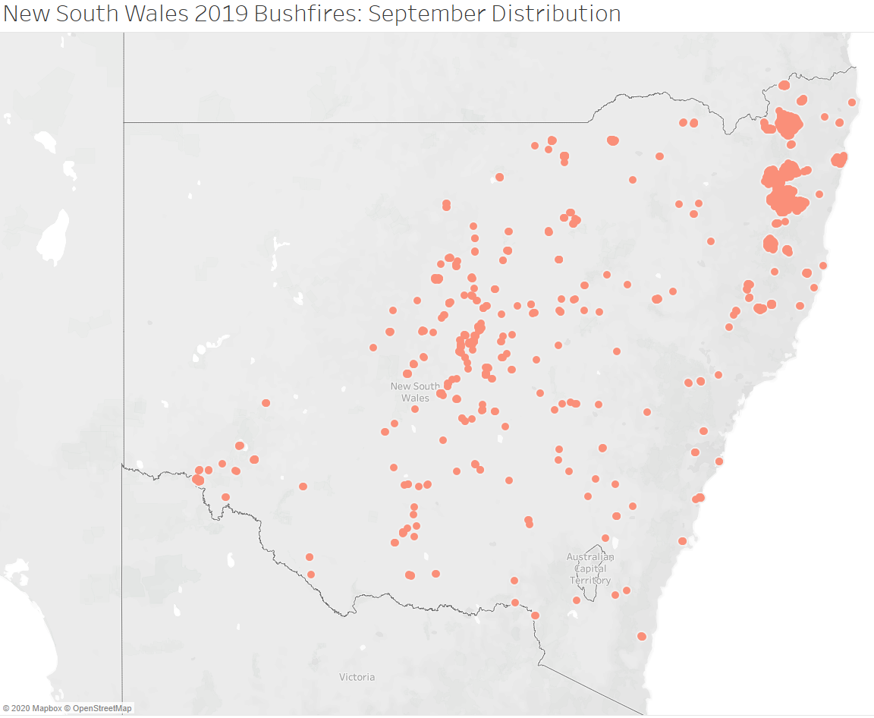
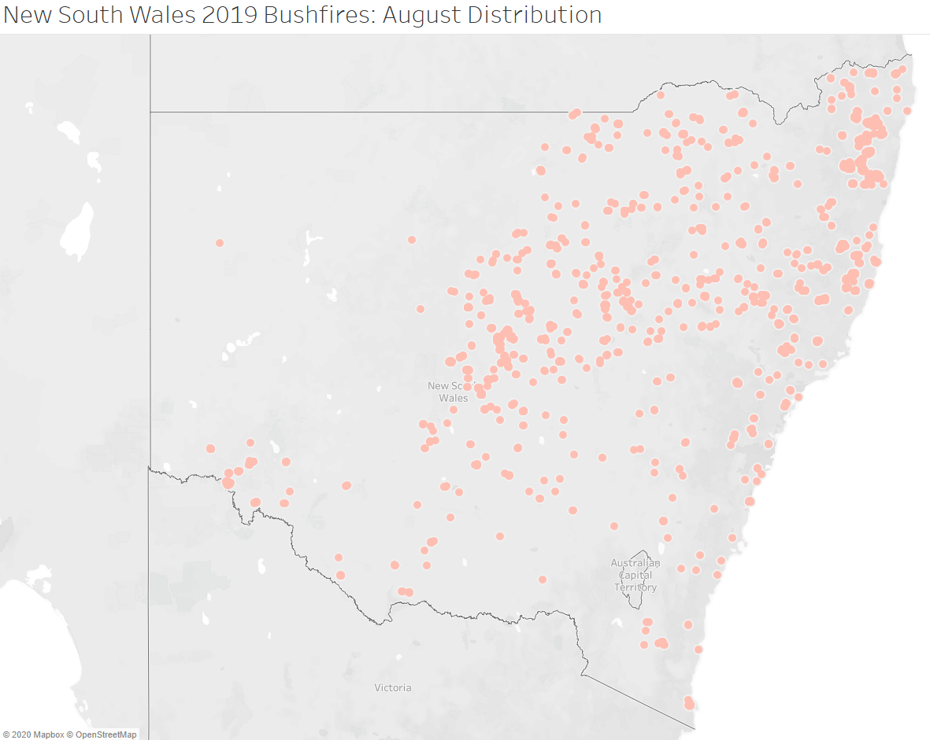
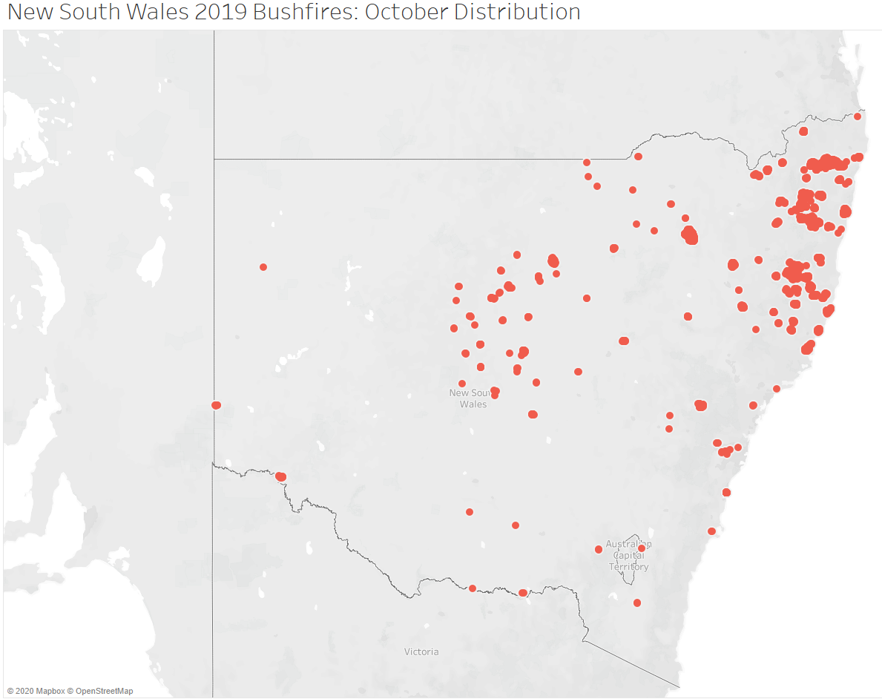
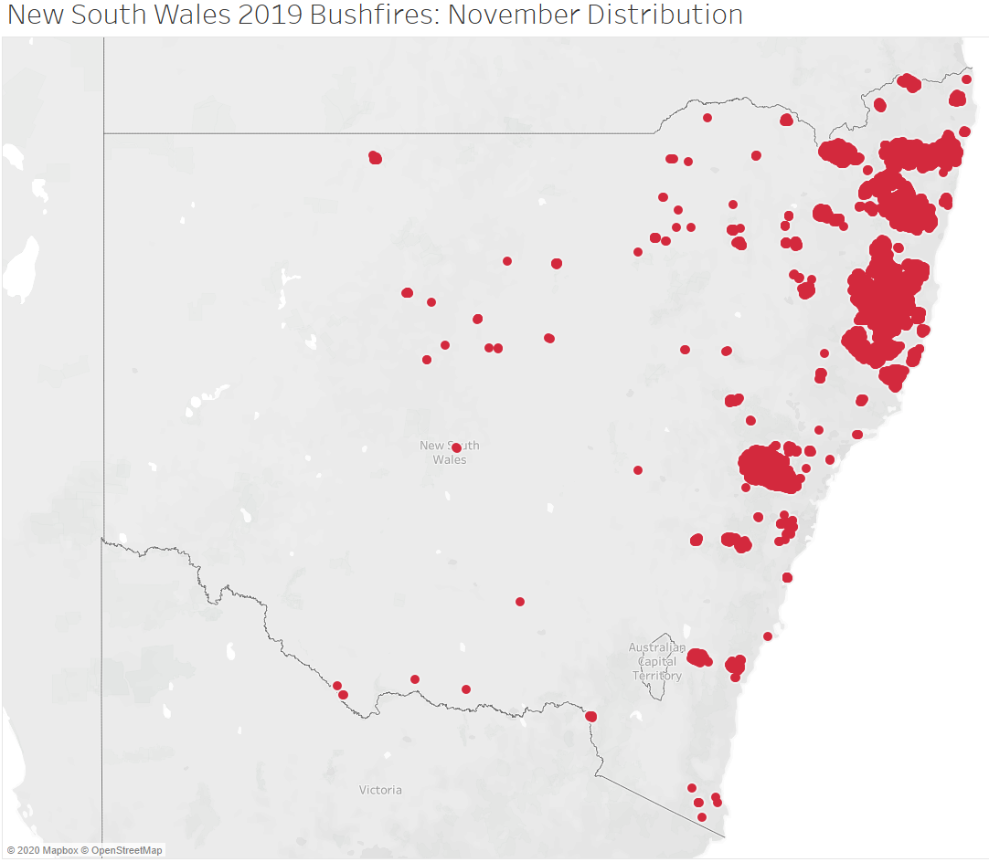
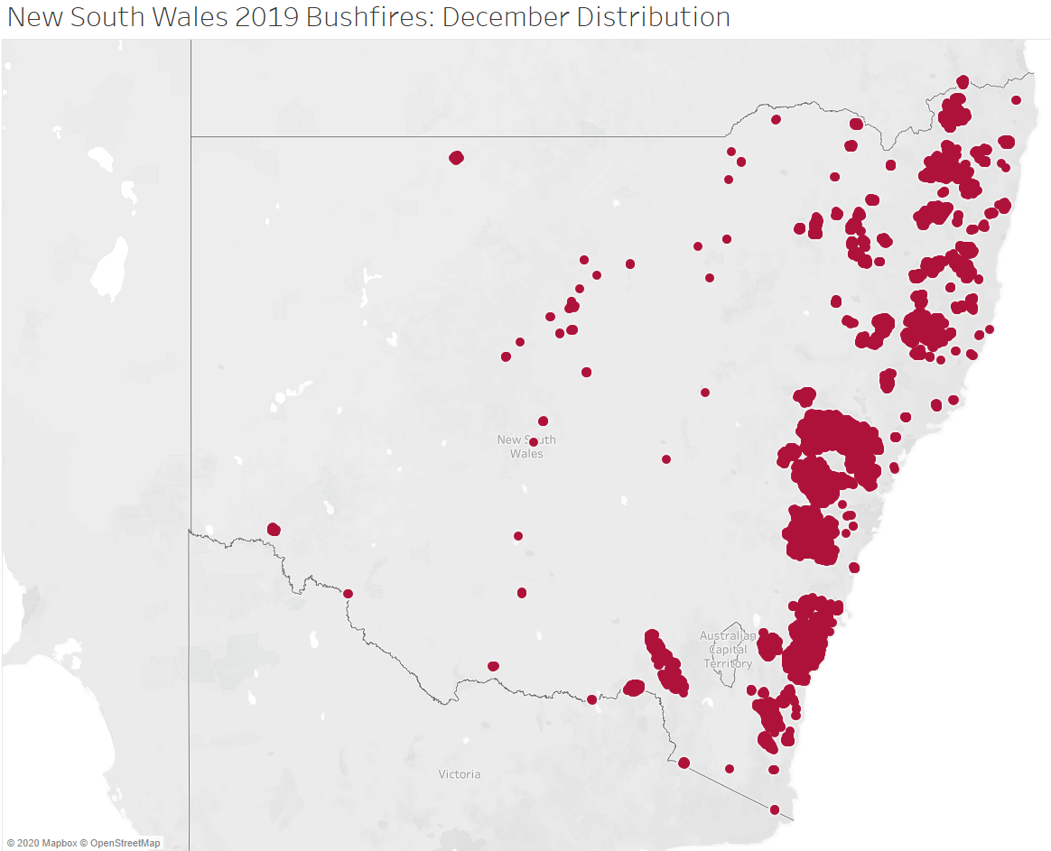
Data Visualization Part 1- Fire Dataset (3)
Notes:
The New South Wales has been most affected by the 2019 Australian Bushfires; therefore, we selected state of New South Wales and visualized the distribution of fires cumulatively by month. The visualization processes are obtaining the New South Wales city administration boundary shapefiles, spatially joining the shapefile with the fire dataset using ArcGIS, exporting the attribute table to excel, importing the excel to Tableau and visualizing in heatmap.
3. New South Wales Monthly Fire Distributions for 2019 Bushfires- August to December

Slide 12
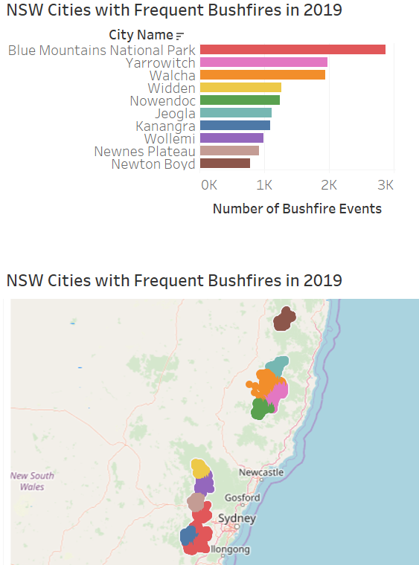
Data Visualization Part 1- Fire Dataset (4)
Notes:
The above graph shows the top 10 Cities in NSW for fire frequency in 2019. We can see that about 3,000 fires occurred in blue mountains national park, which is close to Sydney. About 4,000 fires occured in the city of Yarrowitch and Walcha, in between of Newcastle and Coffs Harbour.

Slide 13
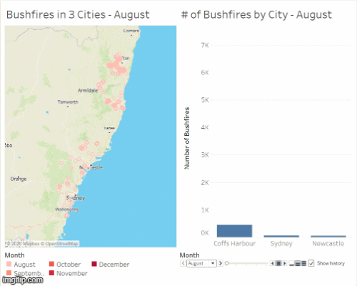
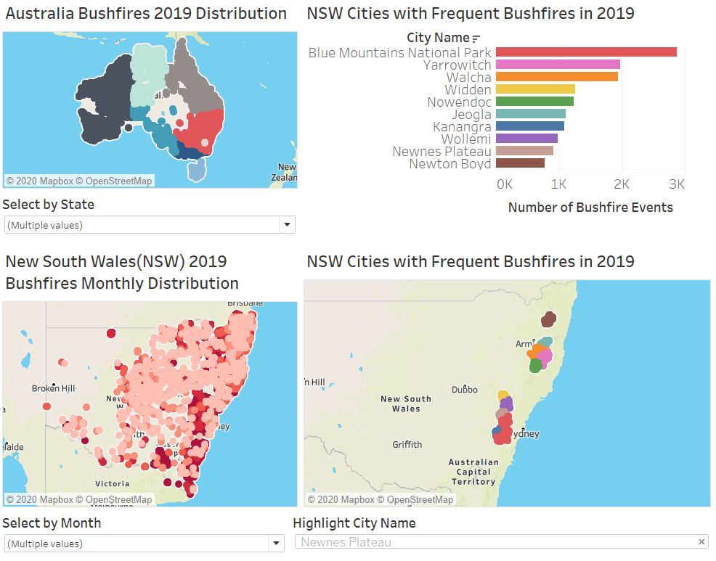
Data Visualization Part 1- Fire Dataset (5)
Notes:
The left hand side dashboard shows the trend of bushfires within 100km in 3 main cities, Coffs harbour, sydney, and newcastle. We chose these three cities because these cities are well-known and have most population in New South Wales. The number of fire events exponentially grows particularly in Coffs harbour.
The right hand side dashboard shows the overall fire events in Australia to New South Wales to cities with frequent bushfires.
Now, Olivia will present weather data analysis in 3 main cities with major fires.

Slide 14
Evaluation from Data Visualization Part 2
Maximum Temperature
Minimum Temperature
Rainfall
Humidity
Wind Speed
Notes:
The main method to analyze the bushfires in this research was to examine the historical weather data leading up to these extreme bushfires as well as the weather data during the bushfires.
Using the results from the Fire Dataset distribution, we know that the state of New South Wales was affected most densely and severely. Considering the top 10 cities in this state with the most fires, we selected 3 major cities along the coast of New South Wales that are located near the top 10 cities affected. These 3 case study locations are Sydney, Coffs Harbour, and Newcastle and we used these 3 locations to examine weather trends leading up to the 2019 bushfires in Australia as well as how these 3 city’s weather features reacted in late 2019 from the nearby bushfires using five major weather factors that can affect the chance of fires: maximum temperature, minimum temperature, rainfall, humidity, and wind speed.

Slide 15
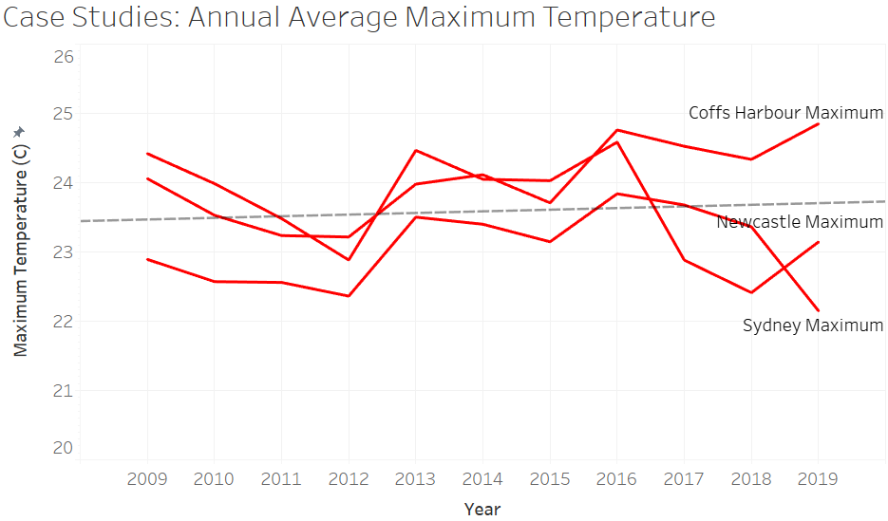
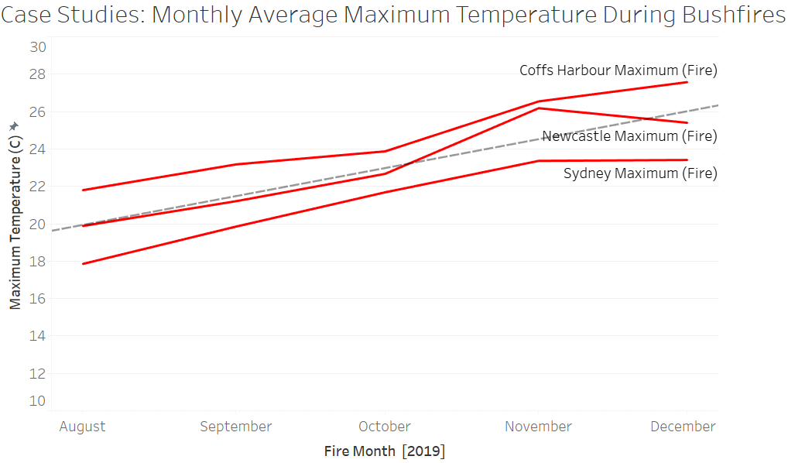
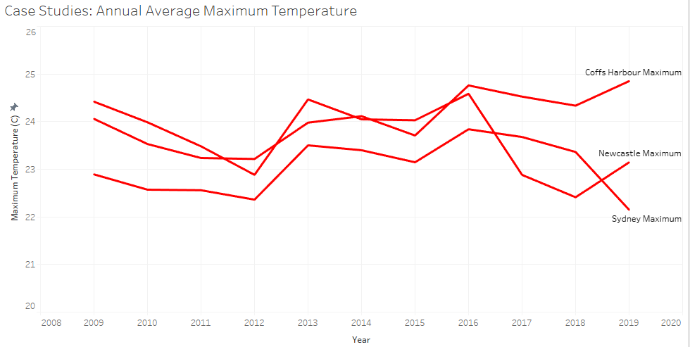
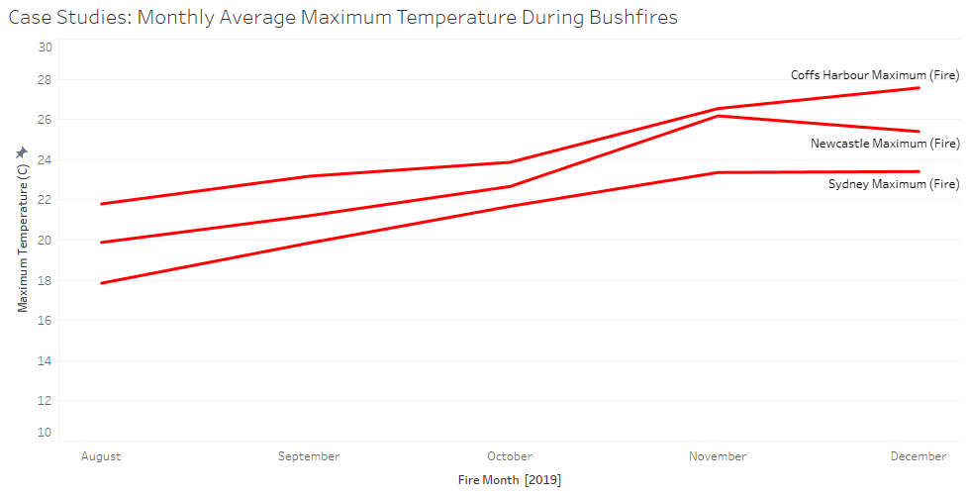
Data Visualization Part 2- Max Temperature
Notes:
Each figure within the weather data analysis is visualizing a weather variable’s values over time and the series lines within the plots indicate the 3 different case study locations. We organized the visualizations by weather variable in order to observe any possible trends that the 3 locations share, either in the 10 years of historic data on the right or the 5 months of data during the fires, on the left. Additionally, A linear trend line was added to the plots in order to clearly visualize how the weather variables were trending over time.
Each of the variables examined for the 10 years of historic data are given with an annual average in order to reduce the noise and seasonality of the data and to give a clear message to the viewer. Similarly, the 5 month weather data analysis during the fires was calculated with a monthly average.
Maximum Temperature:The 10 years of historical weather data on the left shows cyclical increases and decreases for maximum temperature while the August to December 2019 data on the right shows steady growth.

Slide 16
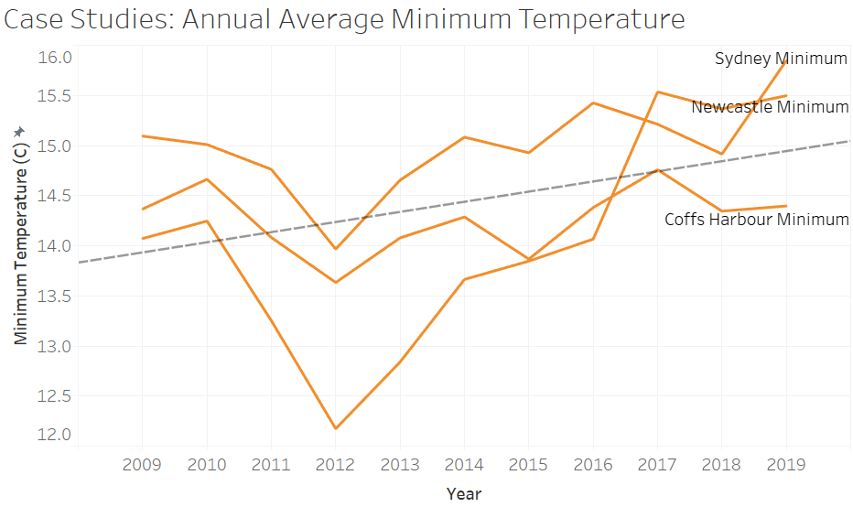
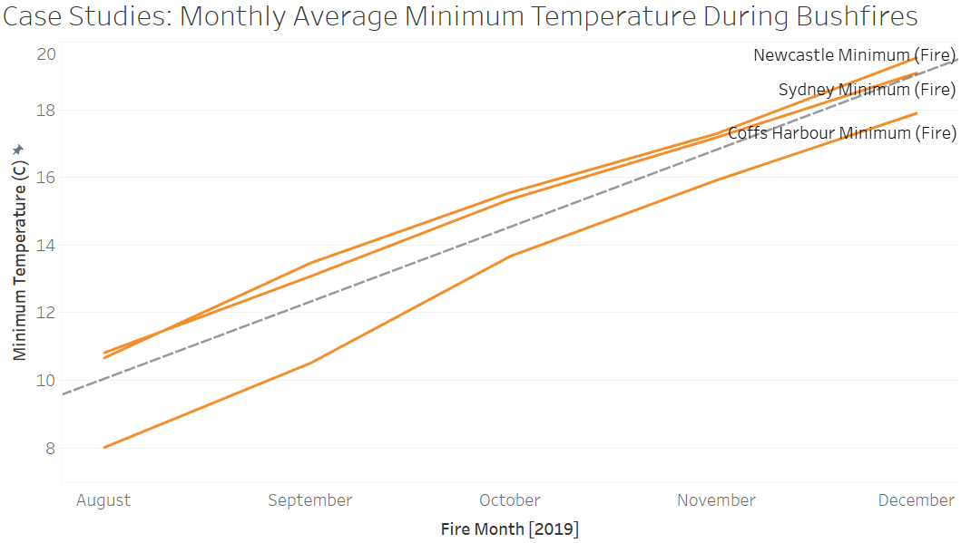
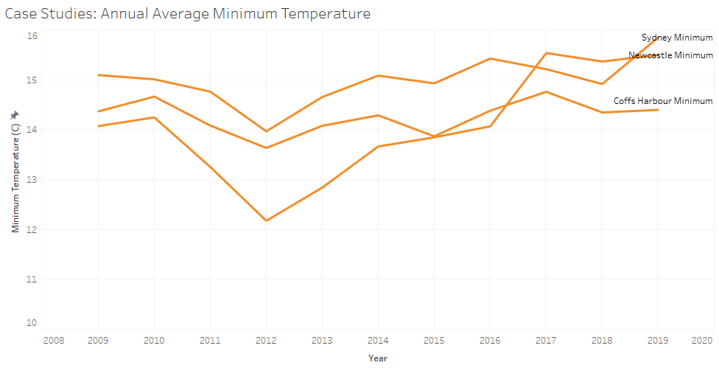
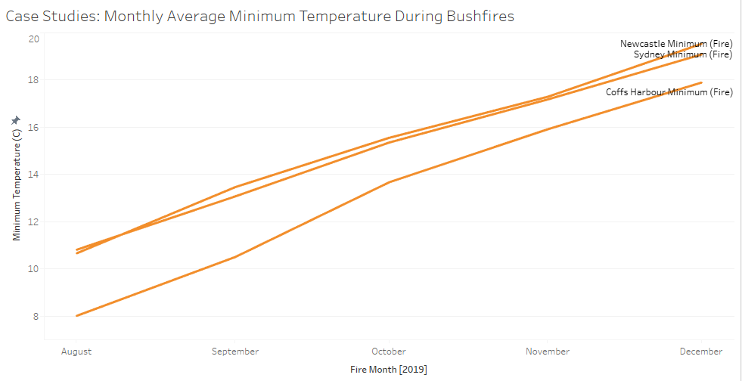
Data Visualization Part 2- Min Temperature
Notes:
Minimum Temperature: The 10 years of historical weather data on the left also shows cyclical increases and decreases, however, has a slight overall increase, while the August to December 2019 data shows a consistent increase in minimum temperature’.
For the 5 months of weather data during the bushfires, we We see a steady and consistent increase in both maximum and minimum temperature whereas it would normally be expected for these variables to drop during these late months of the year from August to December. However, they both continuously rose, suspectedly as a consequence of the severe bushfires surrounding these cities.

Slide 17
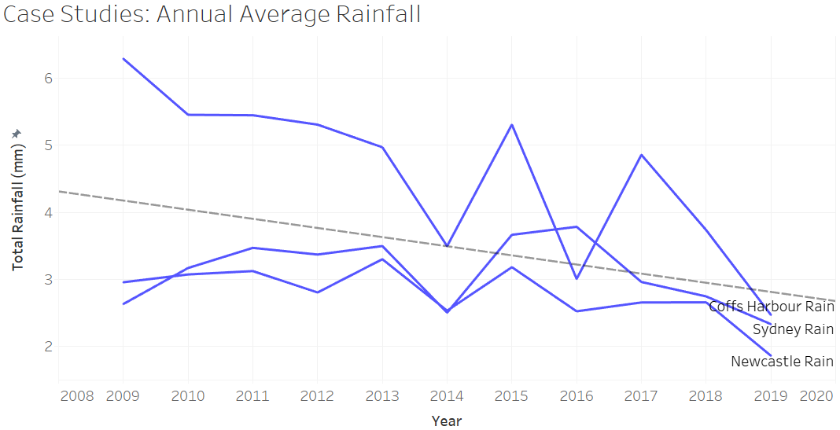
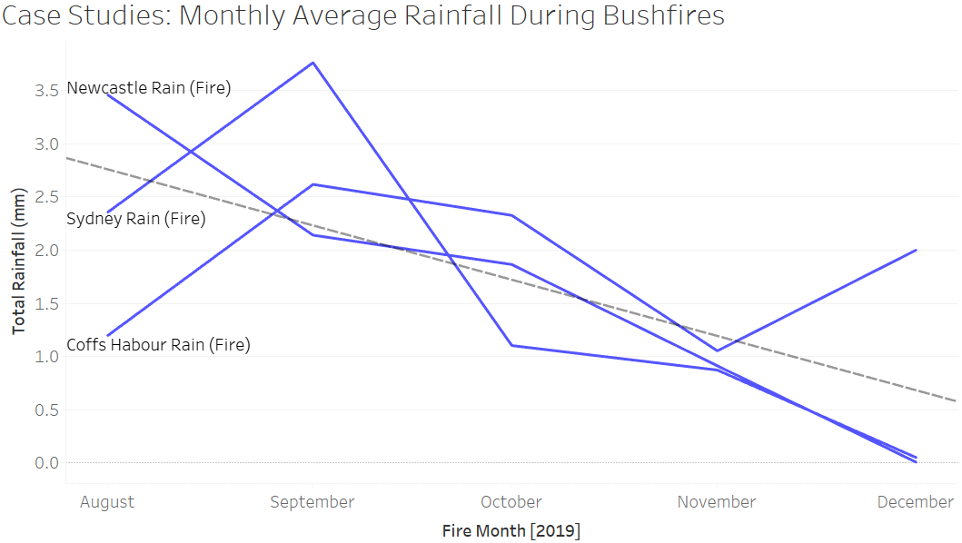
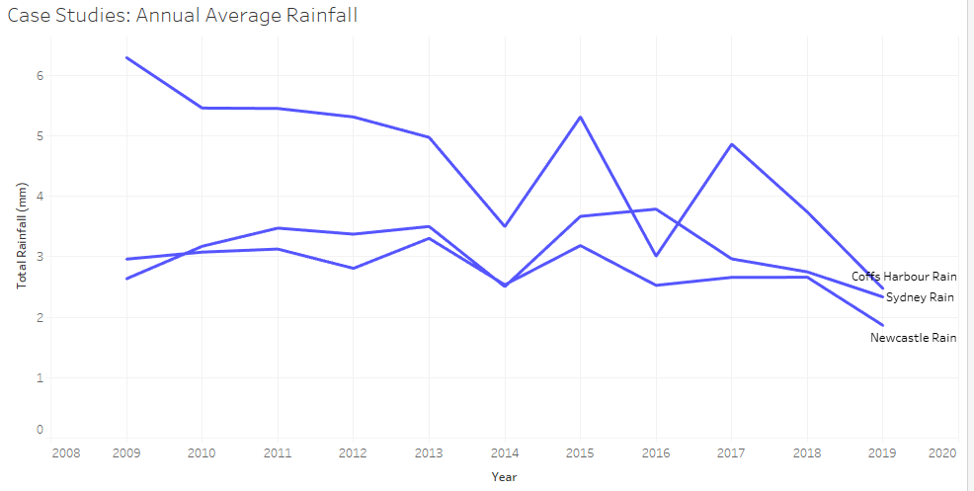
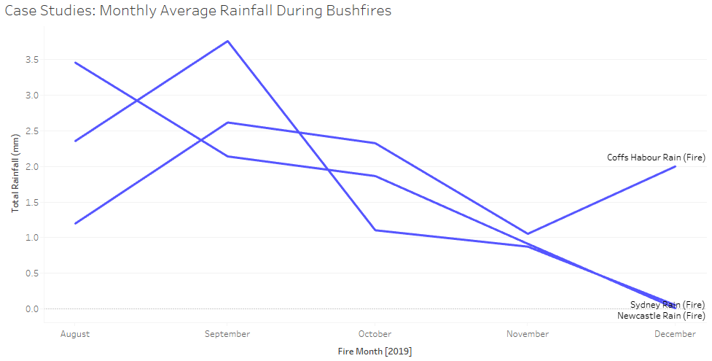
Data Visualization Part 2- Rainfall
Notes:
Rainfall: The 10 years of historical weather data for total rainfall shows a consistent decrease. In particular, the city of Coffs Harbour shows a dramatic decrease from 6mm in 2009 and 2.4mm in 2019. Similarly, The August to December 2019 data on the right shows an overall decrease in rainfall for two of the three case study locations.
Both of these visualizations show overall decrease in rainfall. During the bushfires, It can be assumed that drought would have been a major issue due to lack of rainfall.

Slide 18
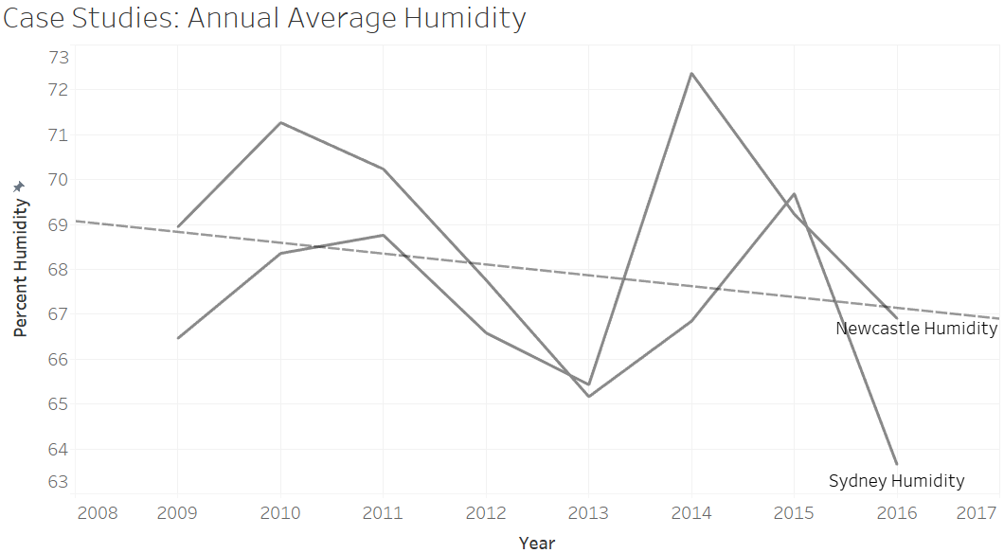
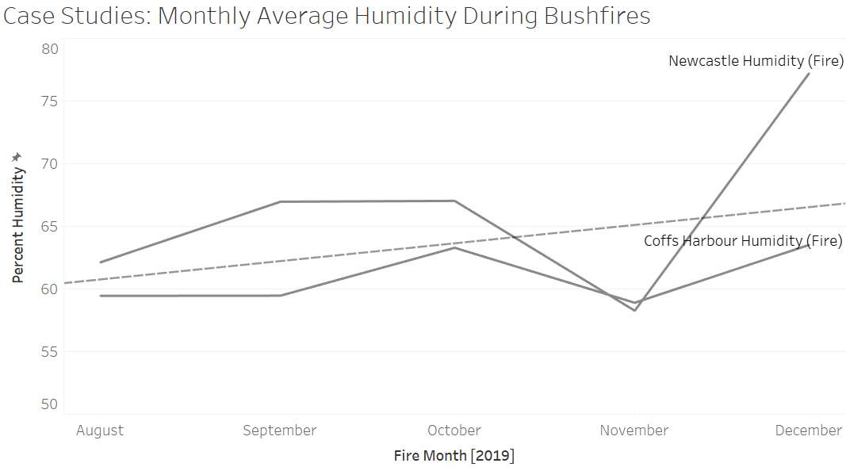
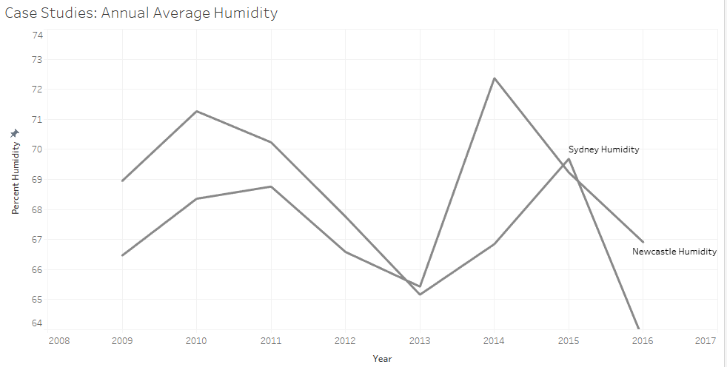
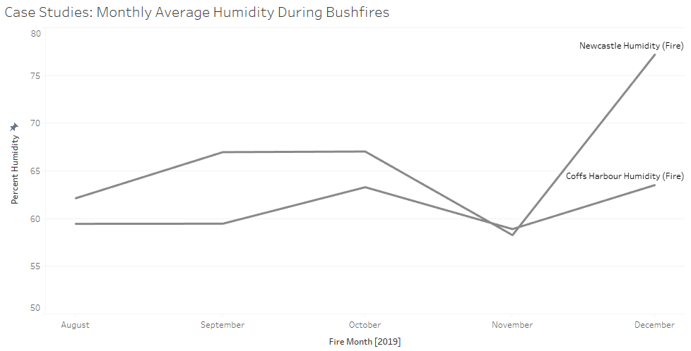
Data Visualization Part 2- Humidity
Notes:
Humidity: The historic data cyclical increases and decreases for relative humidity, with an overall decrease. Whereas the recent weather data during the fires has an overall increasing trend.

Slide 19
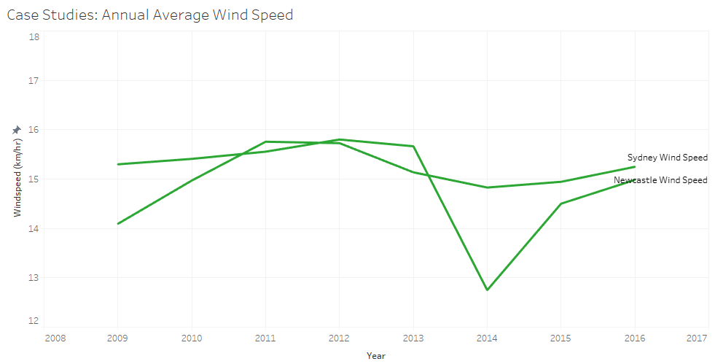
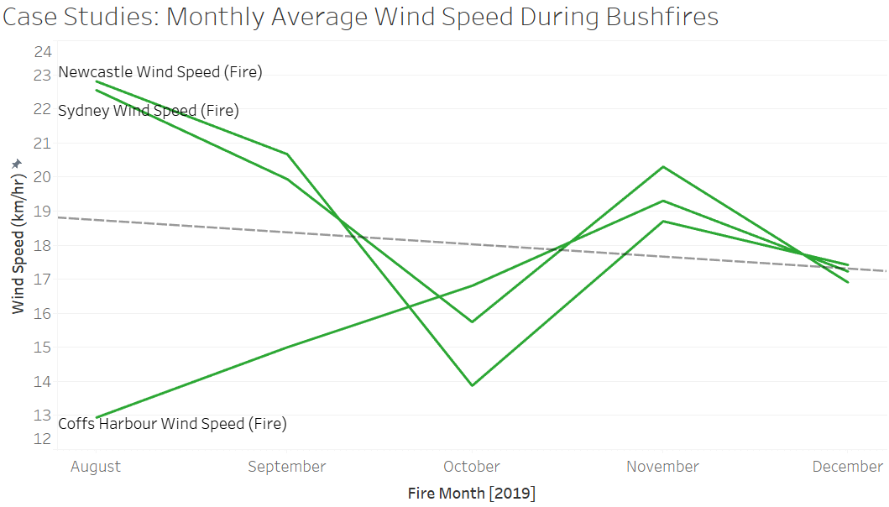
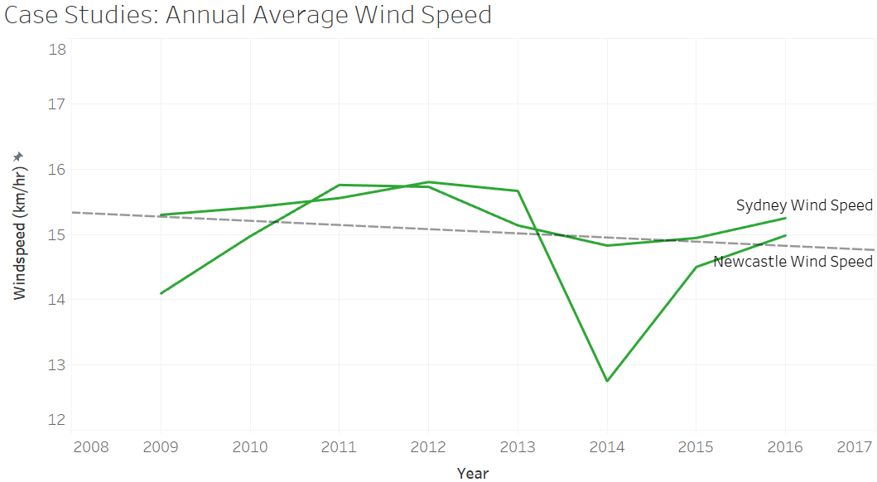
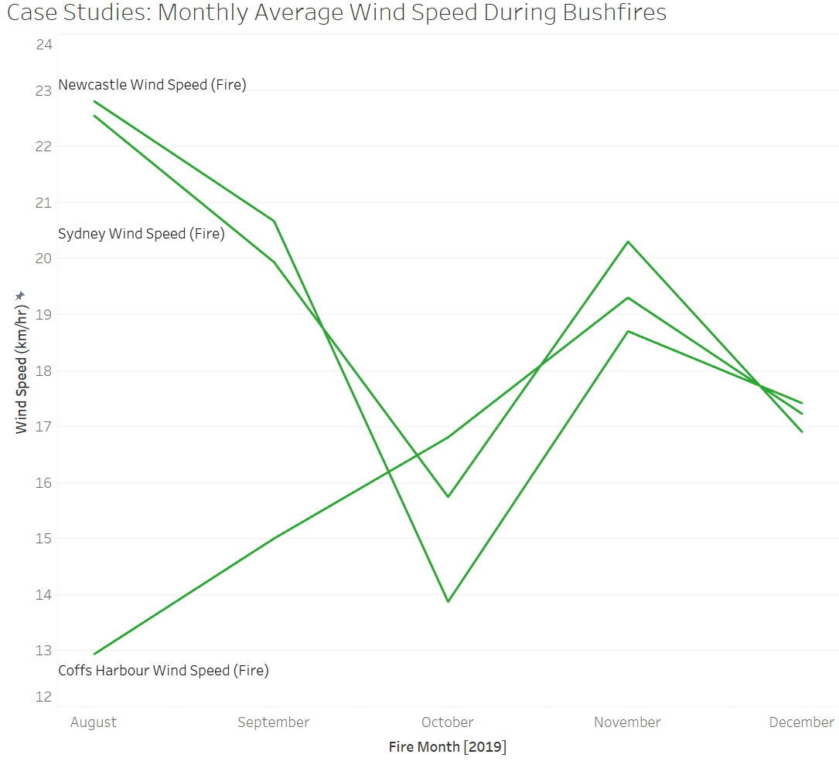
Data Visualization Part 2- Wind Speed
Notes:
Wind Speed: historical data shows that most wind speed ranges from 14 to 16 km/hr. For the fire weather data, we see cyclical increases and decreases in wind speed for Sydney and Newcastle. In Coffs Harbour, however, the wind speed dramatically increased from 13 km/hr in August, when the bushfires began to spread rapidly, gradually up to 19 km/hr in November, then finally to 17 km/hr in December.

Slide 20
Application of Principles
The Gestalt Law of Grouping:
Proximity
Similarity
Good continuation
Symmetry
Periodicity
Miller’s Magic Number 7 (plus or minus 2)
Visualizations form:
Length, width
Orientation
Shape
Size
Enclosure
Data Ink
Effectiveness
Expressiveness
Notes:
Slide 21-29= Sukriti
Proximity = shows small assembled fire data in composition
Similarity = the bushfire event data in the same state are colored-coded
Good continuation = all the time series graphs for the weather data are in good continuation and consistent.

Slide 21
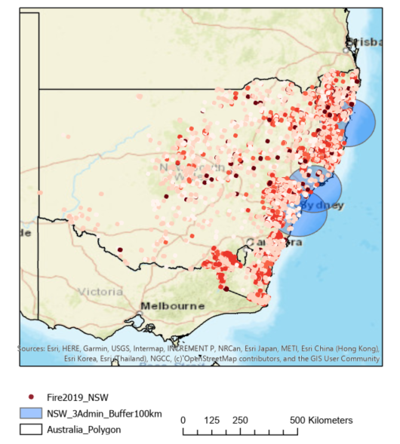
Methods
1. Python: Preprocess dataset using Python
→ Count the number of fire events per date.
→ Count the value of weather data
2. ArcGIS: Spatially join the Australian city and state administration with each fire event.
Visualize the distribution of fires across Australia using the latitude and longitude features from the dataset, plotting the records individually for the identification of dense fire regions. New South Wales had been affected by the Australian bushfires most severely, Therefore, the distribution of fires in New South Wales was visualized cumulatively by month.
Notes:
Python: The dataset was preprocessed using Python in order to count the number of fires/areas burned by the number of records per date and to count the value of weather data
ArcGIS: To obtain city and state administration for each fire event, visualize the distribution of fires across Australia using the latitude and longitude features from the dataset, plotting the records individually for the identification of dense fire regions.
New South Wales had been affected by the Australian bushfires most severely, Therefore, the distribution of fires in New South Wales was visualized cumulatively by month.

Slide 22
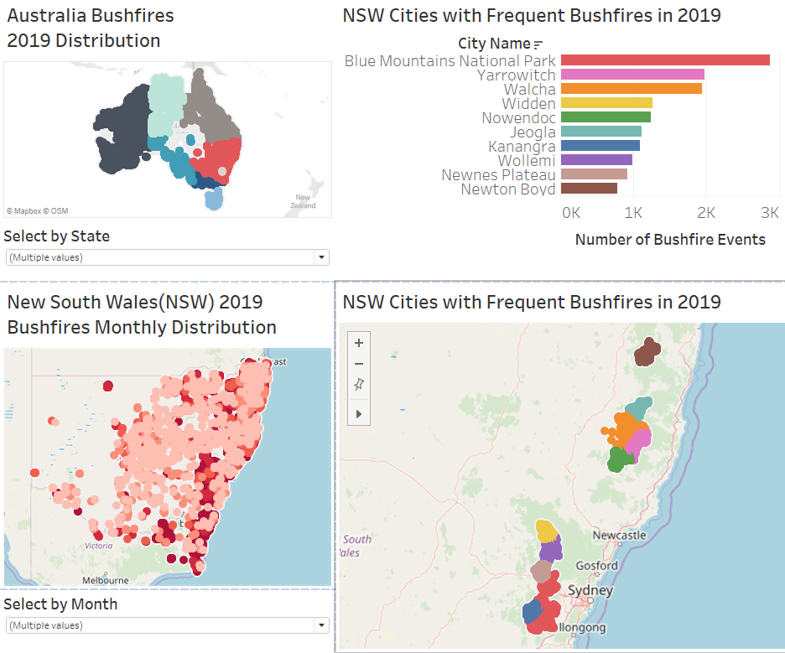
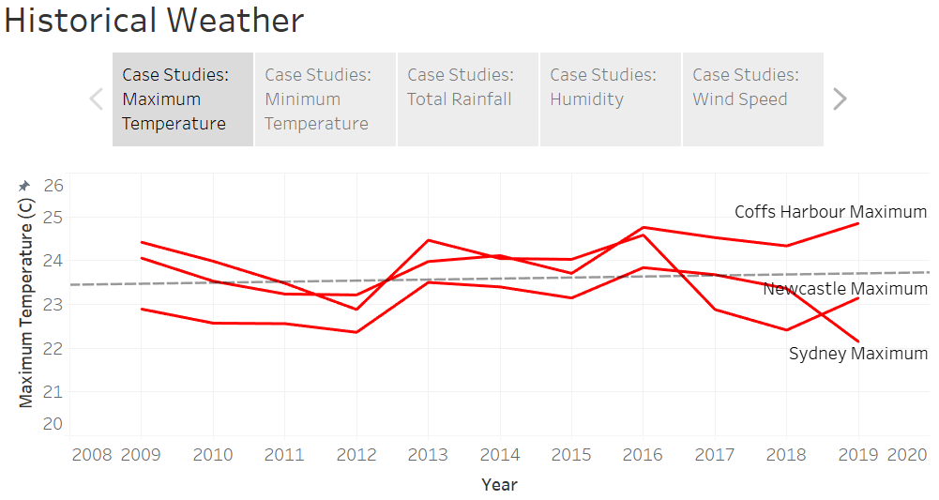
3. Tableau:
Dashboards are developed to showcase three major visualizations to explore the 2019 Australian bushfire occurrences.
Storyboards are developed to demonstrate historical and recent weather data from August 2019 to December 2019
Notes:
The 2019 Australia Bushfire distribution is displayed by an interactive map with a selection of state as an affordance. The next step was to illustrate our case studies in New South Wales, as the
most affected state in Australia by these bushfires, in multiple ways. In order to keep consistent with the approach of exploring the continent-wide bushfire events,we built an interactive map to track monthly fire events along with top citywide fire distributions in 2019.

Slide 23
Visualization Techniques
A dashboard with infographic formats:
Zooming
Clickable
Interactive
Three main types of charts:
Bar graphs: the number of bushfire events vs city name
Line charts: time- series weather data
Heat maps: to represent geographical data
Notes:
Zooming = zooming-in and zoomimg-out
Clickable = drop-down( state-wise and month-wise)
Interactive map similar to animation
Bar graphs are effective
in comparing multiple features and values that fall within
the same datasets. In Figure 6a, the city name is nominal
data, and the number of bushfire events is discrete data as
an integer. Bar graphs are easily displayed and
interpretable with the city values on the y-axis and the
number of bushfire events on the x-axis.
Line charts are effective in
displaying the trends of change through time. Figure 8a-e
and Figure 9a-e illustrate fluctuations and patterns of
annual and monthly data associated with different cities’
weather datasets.
In this
project, heat maps with longitude, latitude, and other
quantitative values are useful to represent geographical
data with color and density.

Slide 24
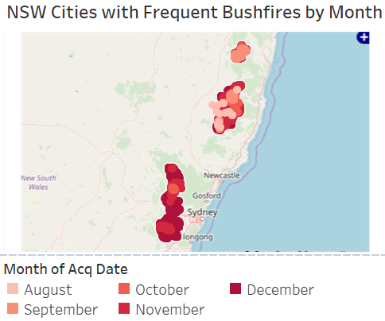
Discussion
Examination of the recent Australia bushfire events in two forms:
1.a The dashboard to visualize the distribution of the fire events as shown on the left side:
1.b Comparison between 2009-2016, or 2009-2019 depending on the variables, historical weather data with the same variable data in 2019 provides observations that the New South Wales region had a warm and dry period during the bushfires.
1.c We built an interactive map to track monthly fire events along with top citywide fire distributions in 2019.
(contd.)
Notes:
We illustrate the recent Australia bushfire events in two forms: Interactive dashboard and time- series plot for weather dataset
The 2019 Australia Bushfire
distribution is displayed by an interactive map with a
selection of state as an affordance. The next step was to
illustrate our case studies in New South Wales, as the
most affected state in Australia by these bushfires, in
multiple ways. In order to keep consistent with the
approach of exploring the continent-wide bushfire events,
we built an interactive map to track monthly fire events
along with top citywide fire distributions in 2019.
The second form to examine this crisis in
Australia was to produce and display time-series plots for
several crucial weather variables related to fire
occurrences such as temperature, humidity, rainfall, and
wind speed.

Slide 25
Discussion (cont.)
2.a Australia was to produce and display time-series plots for several crucial weather variables related to fire occurrences such as temperature, humidity, rainfall, and wind speed.
2.b The time series plot from August 2019 to January 2020 shows the audience how the events developed during this 6-month period: two peak events are observed on September 6, 2019, and January 4, 2020.

Slide 26
Discussion for Data Preprocessing (cont.)
The accuracy and performance of any model influenced by the quality of the dataset.
The preprocessing technique is very important because it makes ready the dataset in that form that the algorithm understands. Preprocessing of the dataset refers to the steps applied to the dataset before applying the mechanisms to the dataset.
Datasets can have missing data, errors, redundancies, noise, and many other problems which makes the data inappropriate to be used directly. Sometimes, size of the dataset (many attributes) affects the performance of the model.
Data preprocessing steps includes data cleaning, data transformation, missing values imputation, data normalization, feature selection, and other steps depending on the nature of the dataset.
For more accurate results, we can improve the quality of the dataset by collecting data from a more reliable sources or by filling the missing values with predictive values.

Slide 27
Future Work
1. Implementation of machine learning algorithms on the full Australian wildfires dataset for the risk prediction analysis of wildfires in the future would be a great approach.
2. Fitting historical weather data into many existing weather prediction models to get climate change scenarios.
3. Extension of this analysis to other regions in Australia, e.g. Queensland, Western Australia. A comparison of the trends of the same weather features in different regions is useful to generate a complete climate change report through key years.

Slide 28
References
[1] Bom.gov.au. 2020. Climate Data Online. [online] Available at: <http://www.bom.gov.au/climate/data/> [Accessed 11 March 2020].
[2] CRC, T., 2020. Fire Fundamentals: Fire Weather. [online] Learnline.cdu.edu.au. Available at: <http://learnline.cdu.edu.au/units/env207/fundamentals/weather.html> [Accessed 11 March 2020].
[3] Kaggle.com. 2020. Fires From Space: Australia. [online] Available at: <https://www.kaggle.com/carlosparadis/fires-from-space-australia-and-new-zeland> [Accessed 11 March 2020].
[4] Kaggle.com. 2020. Rain In Australia. [online] Available at: <https://www.kaggle.com/jsphyg/weather-dataset-rattle-package> [Accessed 11 March 2020].
[5] The Verge. 2020. What You Need To Know About The Australia Bushfires. [online] Available at: <https://www.theverge.com/2020/1/3/21048891/australia-wildfires-koalas-climate-change-bushfires-deaths-animals-damage> [Accessed 10 March 2020].
[6] “NSW Suburb/Locality Boundaries - PSMA Administrative Boundaries,” 17-Feb-2020. [Online]. Available: https://data.gov.au/dataset/ds-dga-91e70237-d9d1-4719-a82f-e71b811154c6/details. [Accessed: 11-Mar-2020]
[7] K. Hennessy, C. Lucas* N. Nicholls* J. Bathols, R. Suppiah and J. Ricketts, “Climate change impacts on fire-weather in south-east Australia”, CSIRO and Bureau of Meteorology, 2005
[8] R. Dutta, A. Das and J. Aryal, "Big data integration shows Australian bush-fire frequency is increasing significantly," Royal Society Open Science, vol. 3, no. 2, p. 150241, 2016.
[9] N. Popovich, D. Lu and B. Migliozzi, "Here’s Where Australia’s Destructive Wildfires Are Burning," The New York Times, 13 January 2020. [Online]. Available: https://www.nytimes.com/interactive/2020/01/02/climate/australia-fires-map.html. [Accessed March 2020].

Slide 29
Group 16 2019 Australian Bushfires and Weather Trend Analysis
Thank You For Your Attention
Any Questions?

